Slide 1
Furniture Sales Forecasting Regression Machine Learning Model
By Ankit B. Raut
Mentorness Internship

Slide 2
Agenda
Objectives
Introduction
Dataset Dictionary
System Design
Methodology
Dataset Reading
Continuous Variable Visual Analysis
Categorical Variable Statistical Analysis
Technology Tested
Decision Tree ML Model Results
Conclusion

Slide 3
Introduction
This dataset includes data of furniture store. It provides detailed information about customer orders, focusing on different aspects of the sales process. The dataset contains information on order IDs, customer details, product categories, sales figures, profits, and shipping methods. It spans multiple regions across the United States and covers different segments such as consumer, corporate, and home office.
Each row represents a unique furniture Order ID with various attributes that may influence sales.

Slide 4
Objectives
The goal of this project is to develop a machine learning model to accurately forecast future sales for a furniture store based on historical data. The dataset includes various features such as order details, customer information, product categories, and sales performance.
By analyzing these features, the model will predict future sales trends, which can help the store in inventory management, marketing strategies, and financial planning.

Slide 5
Dataset Dictionary
Row ID: Unique identifier for each row.
Order ID: Unique identifier for each order.
Order Date: Date when the order was placed.
Ship Date: Date when the order was shipped.
Ship Mode: Mode of shipment (e.g., Standard Class, First Class).
Customer ID: Unique identifier for each customer.
Customer Name: Name of the customer.
Segment: Customer segment (e.g., Consumer, Corporate, Home Office).
Country: Country where the order was placed.
City: City where the order was placed.
State: State where the order was placed.
Postal Code: Postal code for the delivery address.
Region: Region where the order was placed.
Product ID: Unique identifier for each product.
Category: Category of the product (e.g., Furniture, Office Supplies).
Sub-Category: Sub-category of the product (e.g., Chairs, Binders).
Product Name: Name of the product.
Sales: Sales amount for the order.
Quantity: Number of items in the order.
Discount: Discount applied to the order.
Profit: Profit earned from the order.

Slide 6
System Design
A data flow diagram shows the way information flows through a process or system. It includes data inputs and outputs; data stores and the various sub processes the data moves through. DFDs are built using standardized symbols and notation to describe various entities and their relationships. In this project there is one DFD
Furniture Sales Prediction
User

Slide 7







System Design
Different processes are carried out to obtain the actual information such as one hot encoding. Then feature extraction is performed to extract necessary features. User can give an input to the detection model and it will provide an output.
Train Set
Evaluation
Model
Data
Data
Processing
Output
Test Set
Machine Algorithm
Inputs

Slide 8
Methodology
Literature Review
Dataset Collection
Data Pre-Processing
Feature Extraction
Training Set
Testing Set
Decision Tree
Error Calculation
Prediction

Slide 9
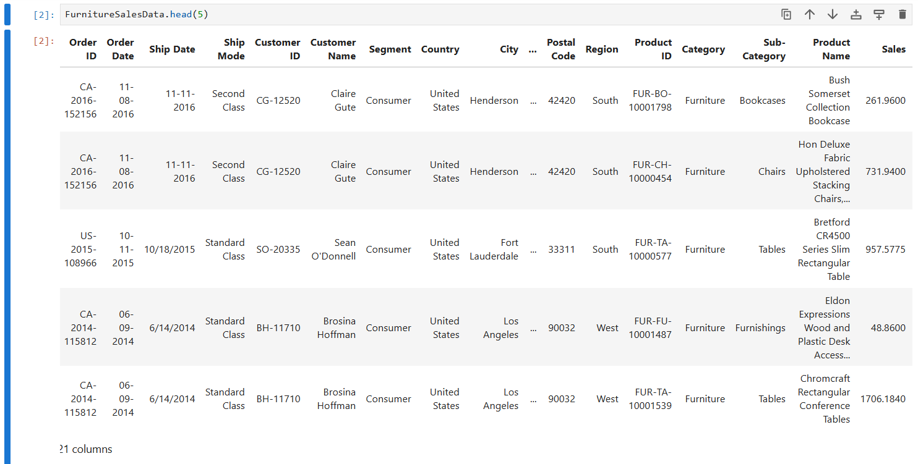
Dataset Reading

Slide 10
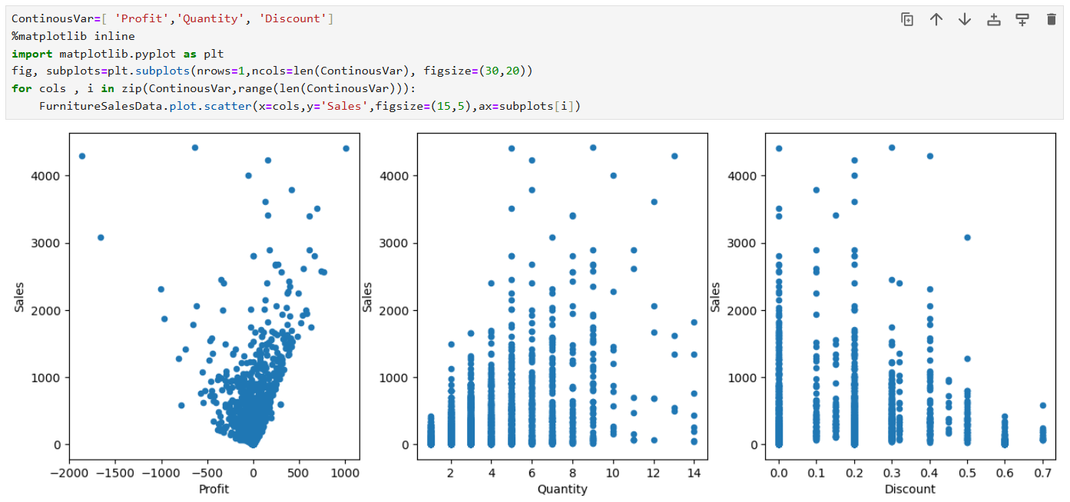
Continuous Variable Visual Analysis
Profit datapoints are correlating with Sales datapoints in a good manner.

Slide 11
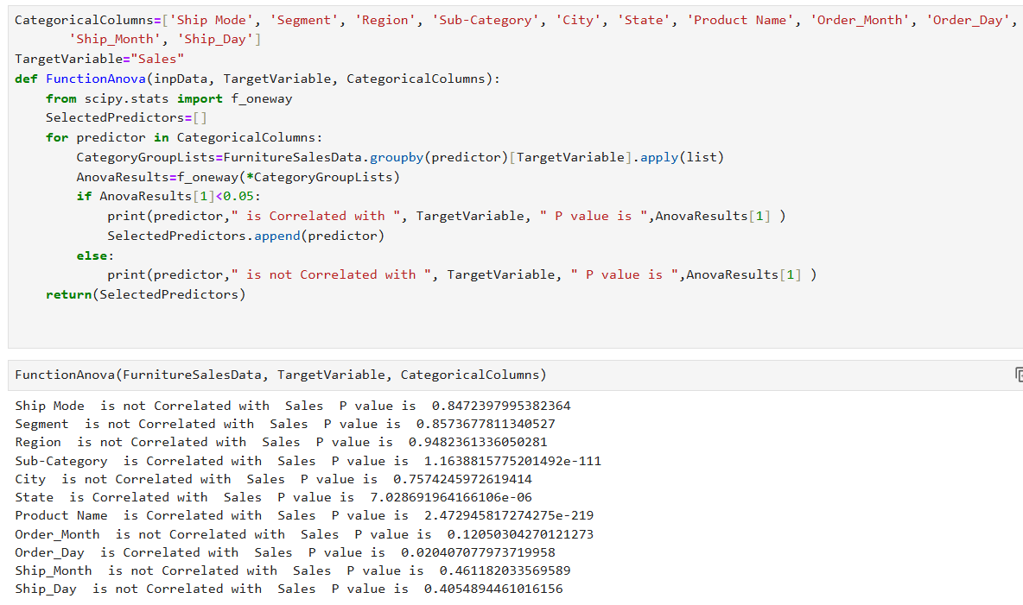
Categorical Variable Statistical Analysis

Slide 12
Technology Tested
Decision Tree Machine Learning Algorithm:A decision tree prediction model is a type of supervised learning algorithm used for both classification and regression tasks. It models decisions and their possible consequences in a tree-like graph structure.
Linear Regression Machine Learning Algorithm : Regression is a method for predicting a dependent component with the help of independent variables. The method is commonly used to predict and calculate correlations between independent and dependent variables. The regression model establishes a linear or exponential connection between independent and dependent variables.

Slide 13
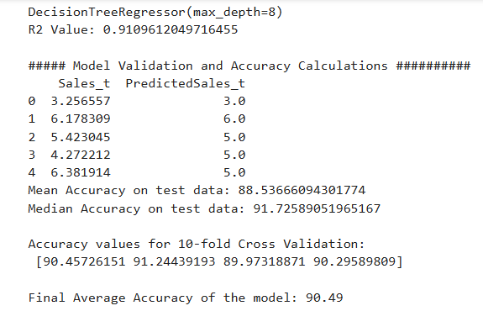
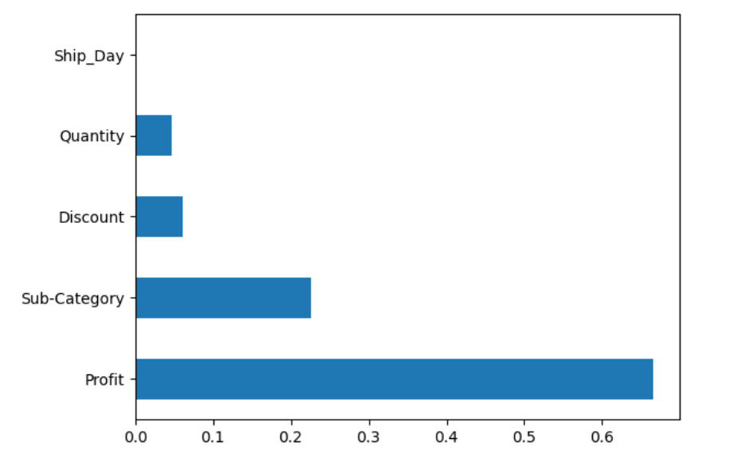
Decision Tree ML Model Results

Slide 14
Conclusion
In this project, A Decision Tree Model was successfully implemented employing various prominent algorithms from the Python libraries and modules.
The R2 value of Decision Tree Model is 0.91 and Final Average Accuracy of the Model is 90.49%. Profit and Sub-Category are more contributing features for getting higher accuracy to Machine Learning Model. So, we are getting more precise and accurate Machine Algorithm Model.

Slide 15
Thank You

